Slide 1
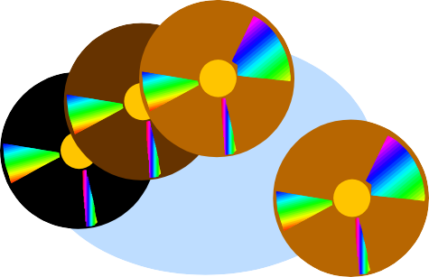
Simulation Software
41
18-Jan-19

Slide 2
Categories of Simulation Software
42
General Purpose Languages
C, C++, Java
Simulation Languages
GPSS, SIMAN, SLAM, SSF
Simulation Environments
Enterprise Dynamics, Arena, SIMUL8

Slide 3

Features of Simulation Languages
43
Some focus on a single type of application
Built in features include
Statistics collection
Time management
Queue management
Event generation

Slide 4

Features of Simulation Environments
44
Some focus on one type of application
Icon based
Analysis of I/O
Advanced Statistics
Optimization
Support for Experimentation

Slide 5
History of Simulation Software
(Nance 1995)
45
1955-60 Period of Search
1961-65 Advent
1966-70 Formative Period
1971-78 Expansive Period
1979-86 Period of Consolidation & Regeneration
1987- 2008 Period of Integrated Environments
2009 + The Future

Slide 6
The Search:: 1955 - 60
46
FORTRAN – one of a few languages
Focus on unifying concepts & reusable functions
General Simulation Program – first effort at
“language” which as a set of functions

Slide 7

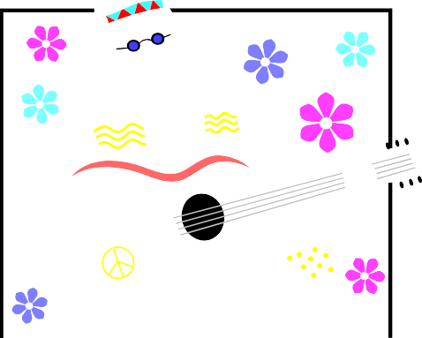
The Advent:: 1961-65
47
GPSS – 1961 @ IBM
Based on block diagrams
Well-suited for queuing models
Expensive at first
SIMSCRIPT – 1963 – Rand Corp.
US Air Force – government is biggest user
FORTRAN influence
Owned by CACI in CA.

Slide 8
The Advent:: 1961-65
(continued)
48
GASP – 1961
Based on Algol, then Fortran
Collection of Fortran functions
SIMULA – extension of Algol
Widely used in Europe
CSL (Control & Simulation Language)

Slide 9
Formative Period:: 1966-70
49
Concepts caused major revisions of languages
Languages gained wider usage
GPSS (several variations)
Simscript II – English-like
ECSL – Europe
SIMULA – added classes & inheritance

Slide 10
The Expansion Period:: 1971-78
50
GPSS/H – 1977
GASP IV – 1974 – Purdue
SIMULA
Attempt to simplify the modeling process
Program generators – severe limitations

Slide 11
Consolidation & Regeneration:: 1979-1986
51
Movement to mini and PC computers
SLAM II (descendant of GASP)
3 world views
Event, Network, Continuous
SIMAN (descendant of GASP)
General Modeling + Block Diagrams
1st first major language - PC & MS-DOS
Fortran functions w/ Fortran programming

Slide 12

Integrated Environments::1987 - 2008
52
Growth on PC’s
Simulation Environments
GUI
Animation
Data analyzers

Slide 13

The Future :: 2009 - 2011
53
What can we expect in the future? (2008)
Virtual Reality
Improved Interfaces
Better Animation
Agent-based Modeling

Slide 14
Evaluating Software
54
Consider multiple issues
Ease of use, support, applicability
Speed of execution
Experimental runs – Debugging
Beware of demos & advertising
Will focus on strengths only

Slide 15
Evaluating Software
55
Can software link to external languages
Carefully consider trade-off between graphical model building & simulation programming language
Costs – one-time vs. licensing

Slide 16
Simulation Software Features
56
Model-building features
Runtime Environment
Animation & Layout features
Output features
Vendor Support - Documentation

Slide 17
GPSS-General Purpose Simulation System
57
Highly Structured
Process Approach
Queuing Systems
Block Diagrams
40 standard blocks
Block corresponds to a statement
Transactions FLOW through the system
18-Jan-19

Slide 18
Other Simulation Software
58
SSF – Scalable Simulation Framework
Application Program Interface (API)
Object-oriented, process view
5 Base Classes
Process, Entity, Event, InChannel, OutChannel
Designed for high-performance computers
Bridges pure Java & simulation languages
18-Jan-19

Slide 19
Simulation Environments ~~Common Features (#1)
59
GUI
Animation
Automatic statistics
Output (tables, graphs, custom)
Analysis
Process world view

Slide 20

Common Features (# 2)
60
Some allow
Event Scheduling
Mixed continuous-discrete models
Animations – 2D & 3D
Business Graphics

Slide 21
Simulation Environments
61
AnyLogic
Arena
AutoMod
Enterprise Dynamics
ExtendSim
Flexsim
ProModel
SIMUL8

Slide 22
AnyLogic
62
Supports: discrete event, agent-based, system dynamics (& combination)
Hybrid: discrete & continuous
Object library
Java models, publish as applets
Animation, Statistics, optimization, debugger

Slide 23
Arena
63
Discrete & Continuous systems
Object-based; GUI
2D, 3D Animation
Business & Manufacturing processes
Supports Analysis

Slide 24
ExtendSim
64
Block-diagram approach
Versions for mixed and for continuous only
Includes C-like programming language
Supports linking to external languages

Slide 25
Flexsim
65
Dynamic-flow systems - manufacturing
Discrete-event, Object-oriented
developed in C++ using Open GL
Animation: 2D, 3D, Virtual reality
simulator;
Drag & Drop

Slide 26
Conclusion
66
Many simulation software environments available
Many do have trial versions to download for trying
Before deciding, consider the features and the add- ons available that will suit your particular environment.

